Slide 1
CONTENT
01
Introduction to Variables
Variable Naming Rules and Conventions
04
02
Data-types
05
Variable Assignment and Manipulation
03
Variable Declaration and Initialization

Slide 2
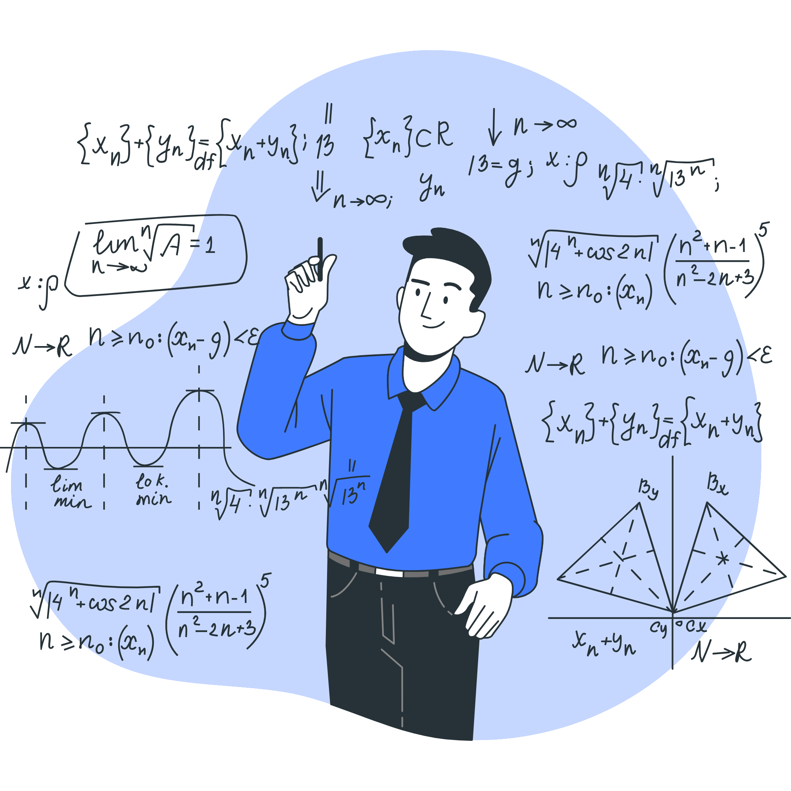
01
Introduction to Variables
Simply what are and why variables?

Slide 3

What are Variables?
A variable in C++ is a name given to memory location.
The value stored in variable can be changed during program execution.
All the operations done on the variable affects that memory location.

Slide 4

Why Variables?
امال هنخزن الداتا فين يسطا

Slide 5
Why Variables? (علم بجد بقى)
Variables are used to store information to
Be referenced and manipulated in a computer program.
They also provide a way of labeling data with a descriptive name, so our programs can be understood more clearly by the reader and ourselves.
It is helpful to think of variables as containers that hold information.

Slide 6
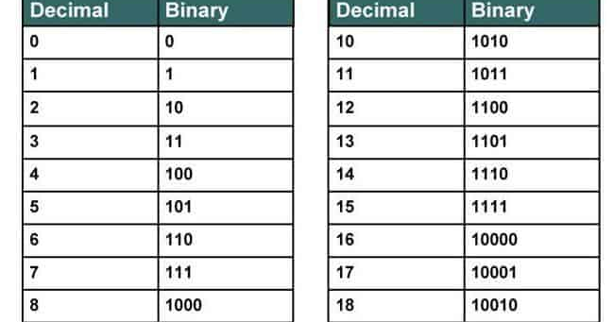

Did you know that the Binary system consist of only 0s and 1s

Slide 7
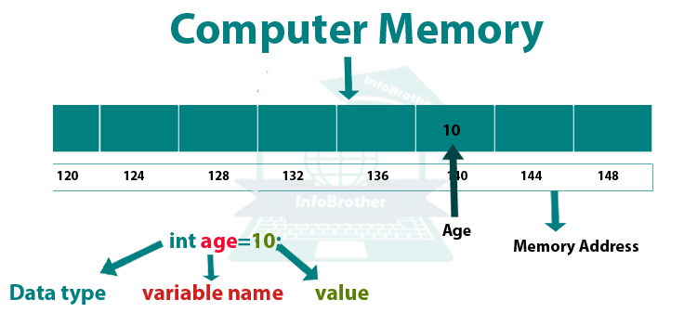
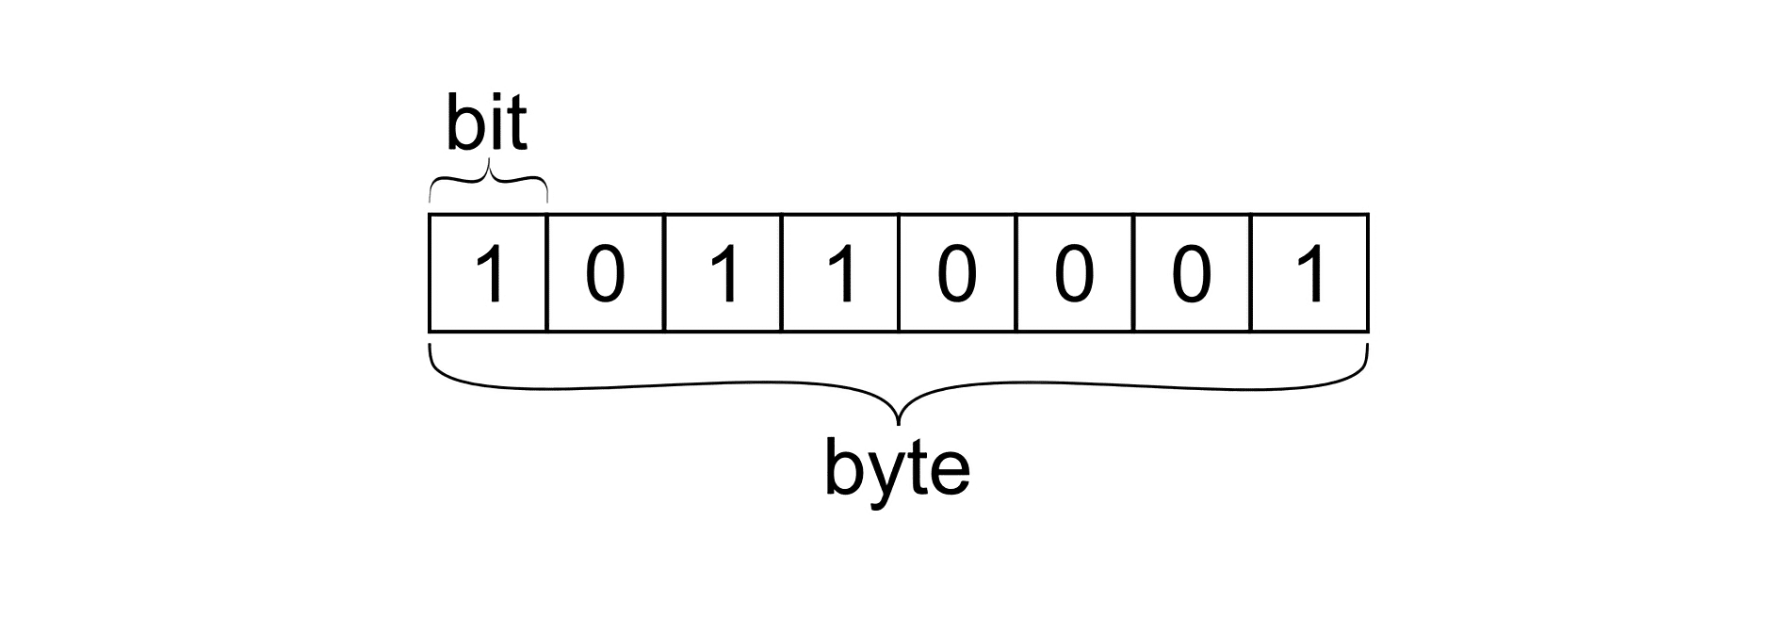

Slide 8

02
Data-Types
What types of Data can we work with?

Slide 9
Primitive Data-types
Data-type | Meaning | Values | Size (in Bytes) | Capacity
int | Integer | (1, 0, -10, 100, 2, -1234) | 2 or 4 | -2,147,483,648 to 2,147,483,647
float | Floating-point | (64.74,-1.2, 2.0, 0.34, 0.0) | 4 | -3.4*10^38 to 3.4*10^38
double | Double Floating-point | (134.64534) | 8 | -1.7*10^308 to 1.7*10^308
char | Character | (‘a’, ’v’, ‘1’, ‘A’, ‘!’, ‘#’, ‘ ‘) | 1
bool | Boolean | (true, false, 0, 1) | 1

Slide 10
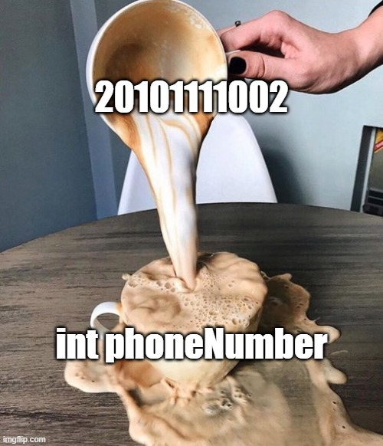
Overflow
Be careful of Overflow!!
If you assign a value to a Variable that is more than the capacity of the declared Data-type it will cause an Overflow and mess up the value.

Slide 11
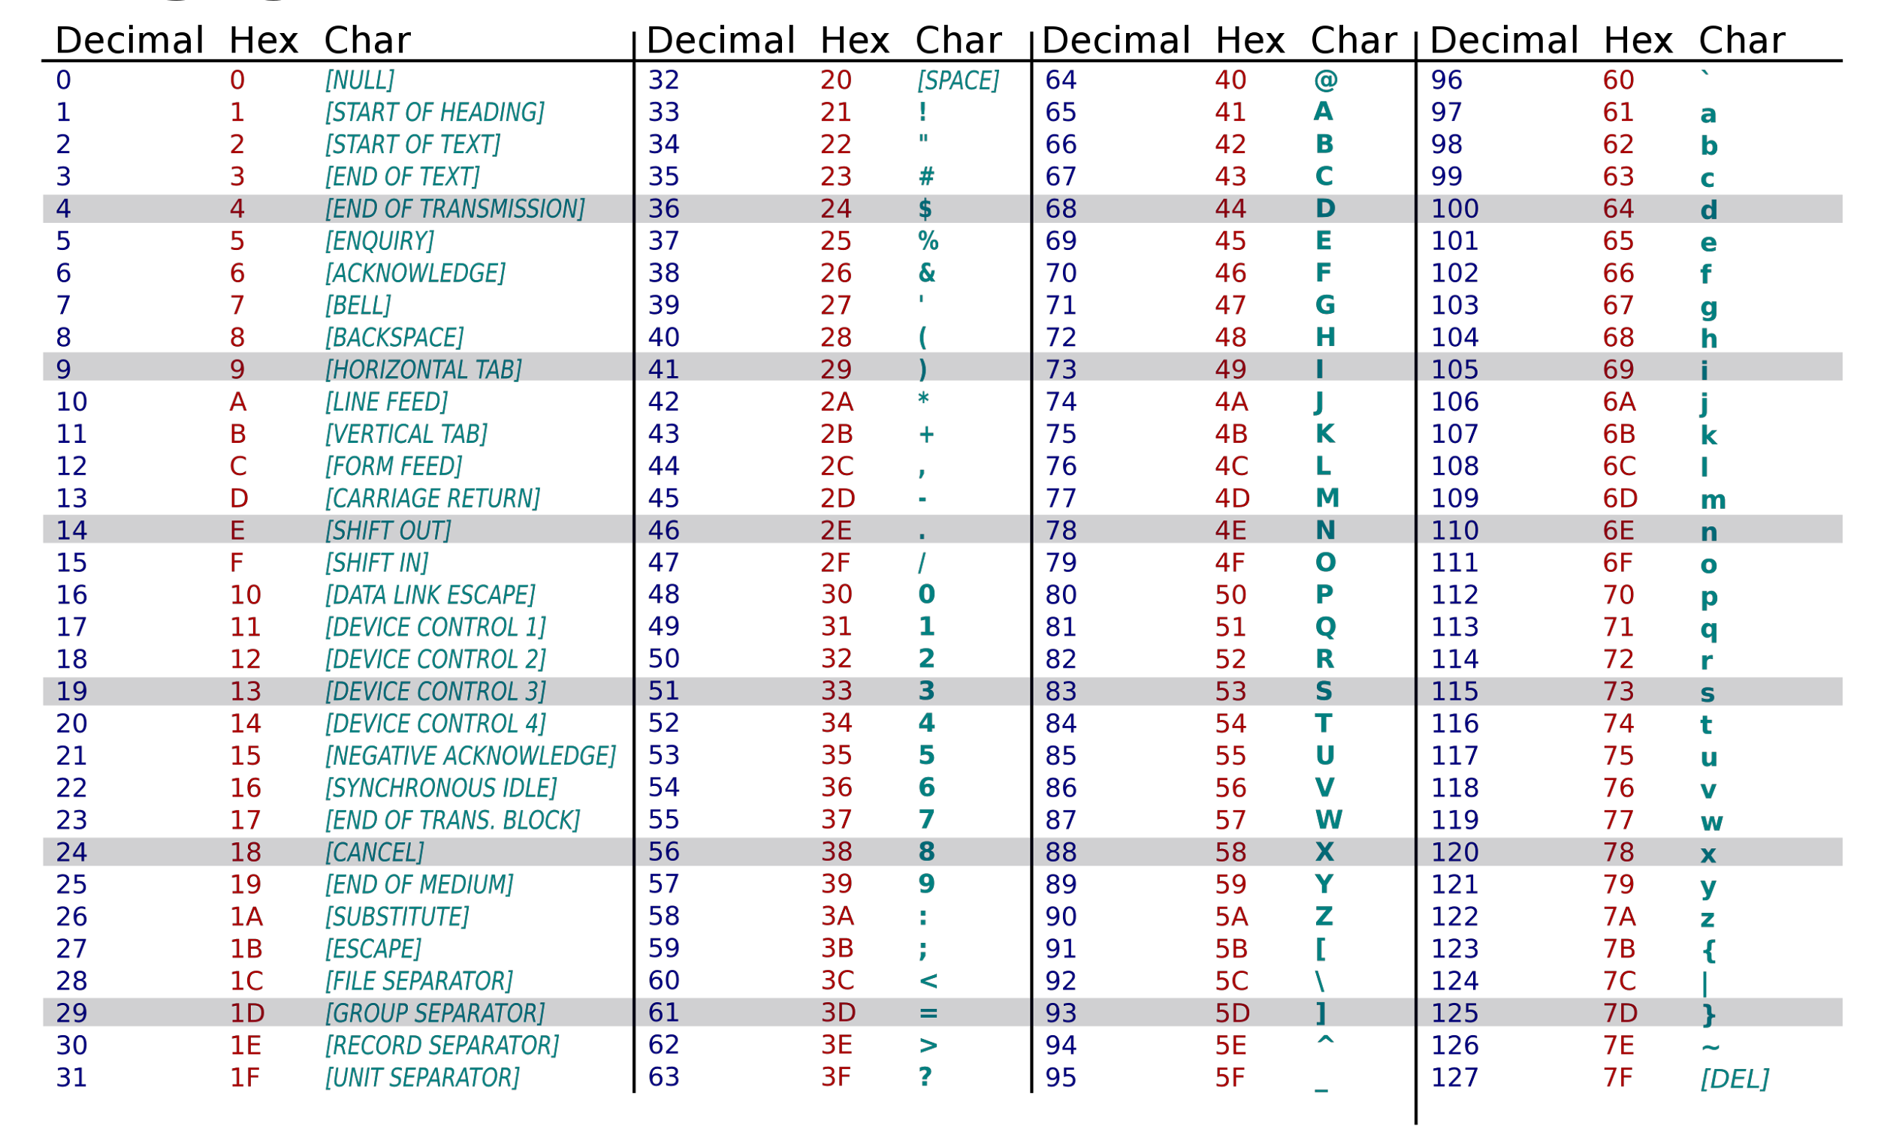
ASCII Table

Slide 12

03
Variable Declaration and Initialization
How to Declare and Initialize a Variable

Slide 13
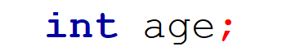
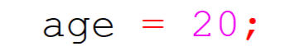
The difference between Declaration & Initialization
Declaration
A declaration specifies a unique name for the entity, along with information about it’s type and other characteristics In C++ the point at which a name is declared is the point at which it becomes visible to the compiler.
Initialization
Initialization of a variable provides it’s initial value at the time of construction. The initial value may be provided in the initializer section of a declarator or a new expression.

Slide 14
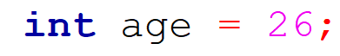
Variable Declaration & Initialization in one line
Data-type
Value
Variable name

Slide 15

What is Garbage
Value?
A garbage value occurs when you allocate a memory for your variable, but you don’t assign a value to your variable .
The memory of the variable may still have a value from the previous program. We called the value garbage. This is an undefined behaviour, which is, yeah, the behavior C++ does not define.

Slide 16
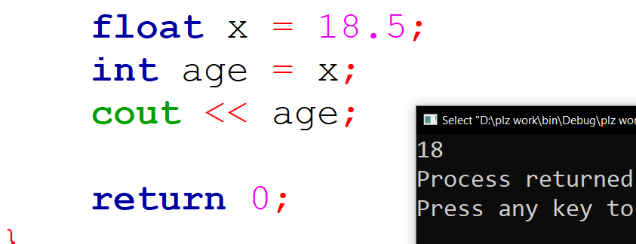
Type-casting
A type cast is basically a conversion from one type to another.
-Implicit Type Conversion Also known as ‘automatic type conversion’.
Done by the compiler on its own, without any external trigger from the user.
There’s another type
Called Explicit Type Conversion
but we’ll talk about that later in detail.

Slide 17
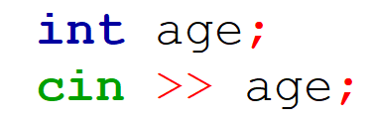
Input Operation
أداة الاستقبال
(لغاية ما نقف على رجلينا)
Variable name

Slide 18

04
Variable Naming Rules and Conventions
Ethics and best practices for naming variables

Slide 19
Variable Naming Rules
Names can contain letters, digits and underscores.
Names cannot begin with a number
Names are case sensitive ( myVar and myvar are different variables)
Names cannot contain whitespace or special characters like !, #, %, etc.

Slide 20
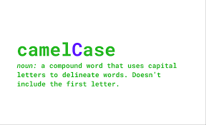
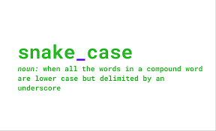
Variable Naming Conventions

Slide 21
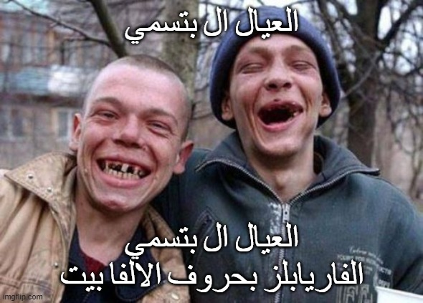

Slide 22

05
Variable Assignment and Manipulation
ازاي تهشتك الفاريابل

Slide 23
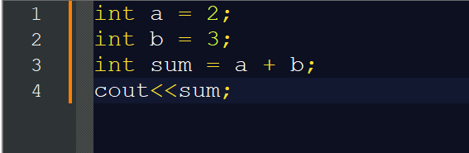
Operator
An operator is a symbol that tells the compiler to perform specific mathematical or logical manipulations.

Slide 24
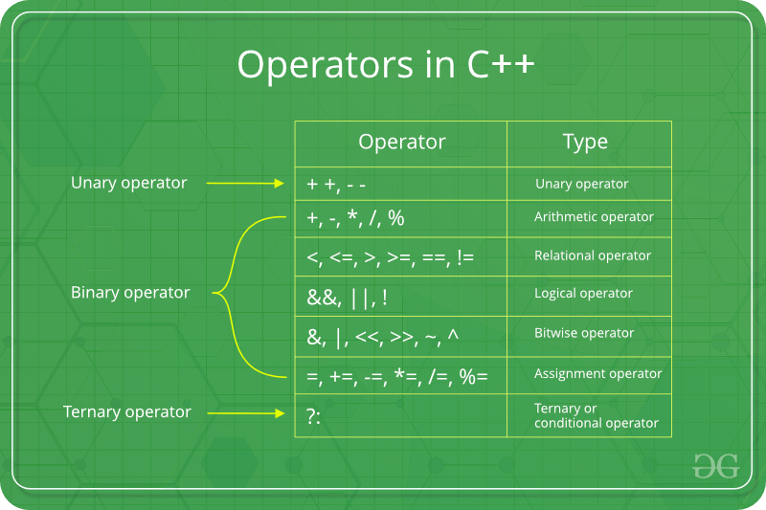
Operators in C++

Slide 25
CONTENT
01
Control Flow
Logical Operators
04
02
What are conditions in programming?
05
Using conditions in C++
03
Relational Operators

Slide 26
01
What are conditions in programming?
What is Conditions and why it is important?

Slide 27
What are conditions ?
A condition is a logical statement that is either true or false.
Conditions help us make decisions in a program.
Conditions control the flow of a program.
Without conditions, programs would only run in a straight line, performing the same actions regardless of the context.

Slide 28
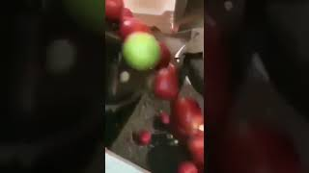
Control flow

Slide 29
02
Relational Operators
What is relational operators?

Slide 30
Relational Operators
Operators used to compare Two values, returning true or false.
Operator | Description | Example a = 5 b = 5 c = 3 | Result
== | Equal to | a == b | True
!= | Not equal to | a != c | True
> | Greater than | a > b | False
< | Less than | a < c | False
>= | Greater or equal | b >= c | True
<= | Less or equal | b <= a | True

Slide 31
03
Logical Operators
What is logical operators?

Slide 32
Logical Operators
Logical operators combine multiple conditions.
Operator | Name | Description
&& | AND | All conditions must be true.
|| | OR | One condition must be true
! | NOT | Reverses condition

Slide 33
04
Using conditions in C++
How to use conditions in C++?

Slide 34
Syntax
Use the if statement to specify a block of C++ code to be executed if a condition is true.
int main(){
if (condition) {
// Code to execute if condition is true
}
//The rest of code
}

Slide 35
TRUE
FALSE
if (condition) {
1 // Code
}
2 //The main code
if (condition) {
// Code
}
//The main code

Slide 36
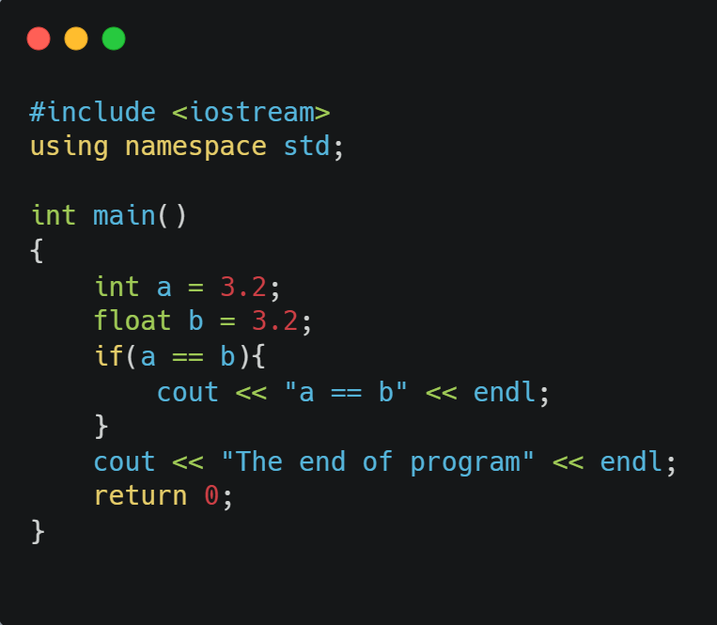
Bonus ^ ^
What is the output? why?

Slide 37
else & else if
IF (or) Else 🡪 rest of code
IF (or) Else if (or) Else 🡪 rest of code
if (condition1) {
//condition1 is true
}
else if (condition2) {
// condition1 is False condition2 True
}
else {
// Runs if none of the above are true
}
if (condition) {
//condition is true
}
else {
//condition is false
}

Slide 38
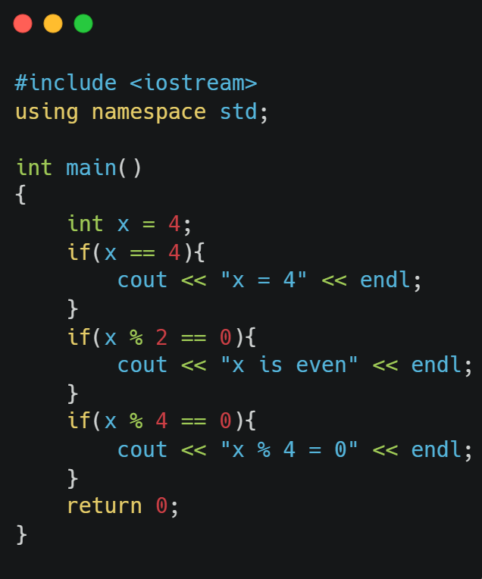
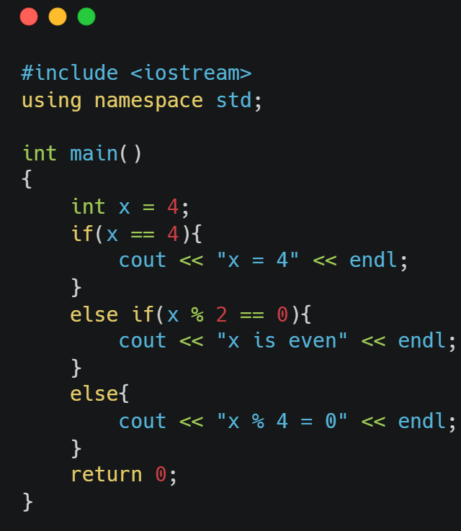
Bonus ^ ^ WHAT IS THE DIFFERENCE?

Slide 39
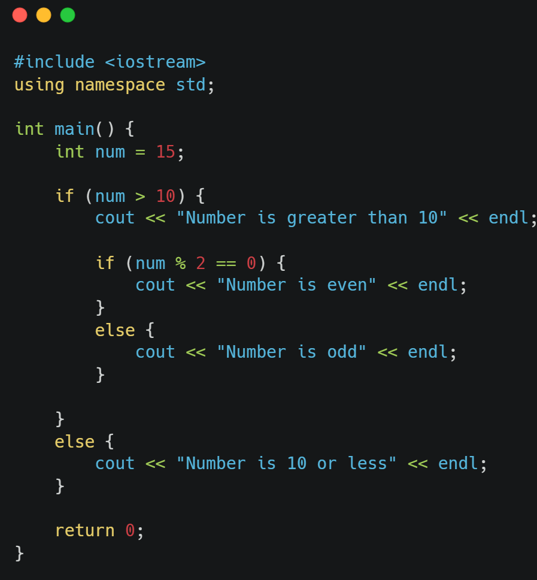
Nested if
A nested if is when an if statement is placed inside another if statement.

Slide 40
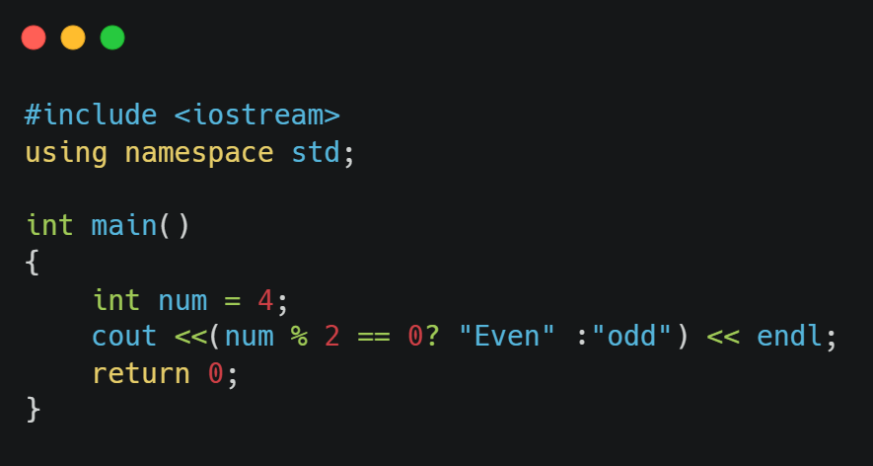
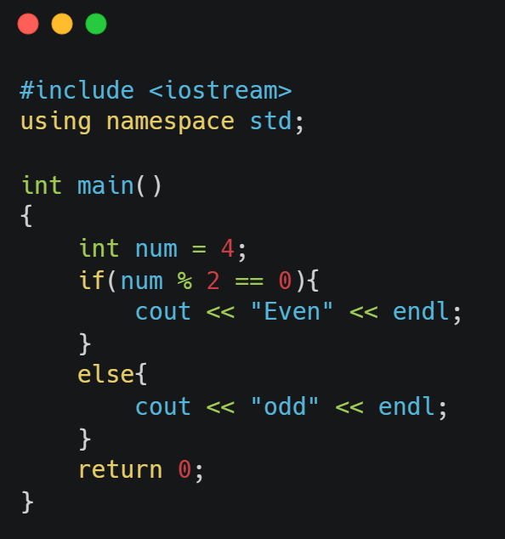
Another Method
Condition? If True : If False;
🡺

Slide 41
CONTENT
01
Introduction to Loops
04
For loop
02
While loop
05
Scopes
03
Infinite loop
06
Nested loops

Slide 42
01
Introduction to loops
التكرار مفيد للشطار

Slide 43
What are loops & why do we use them
What are loops?
Loops are control statements that can execute a block of code as long as a specified condition is reached.
Why would we use them?
Loops are handy because they save time, reduce errors, and they make code more readable.

Slide 44
02
While loops
طول ما الدنيا دي بينا بتلف احنا هنفضل كتف في كتف

Slide 45
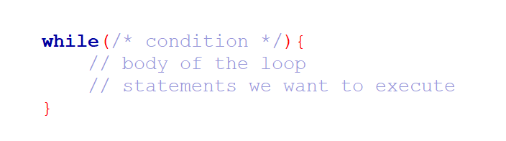
While loop
The while loop loops through a block of code as long as a specified condition is true:
Syntax:

Slide 46
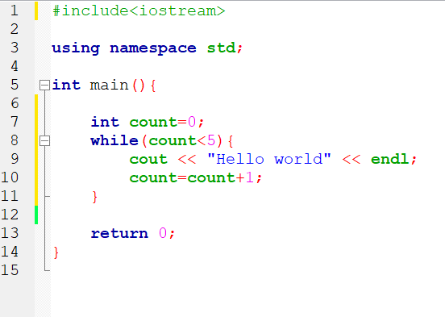
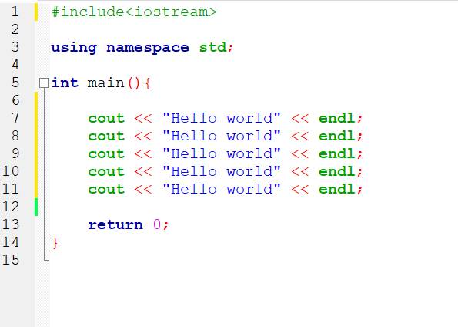
Coding Examples
Example showing how using loops saves time and make your code more readable:
Code 1
#include <iostream>
Using namespace std;
Int main(){
cout<< “Hello World” << endl;
}
Code 2
#include <iostream>
Using namespace std;
Int main(){
cout<< “Hello World” << endl;
}

Slide 47
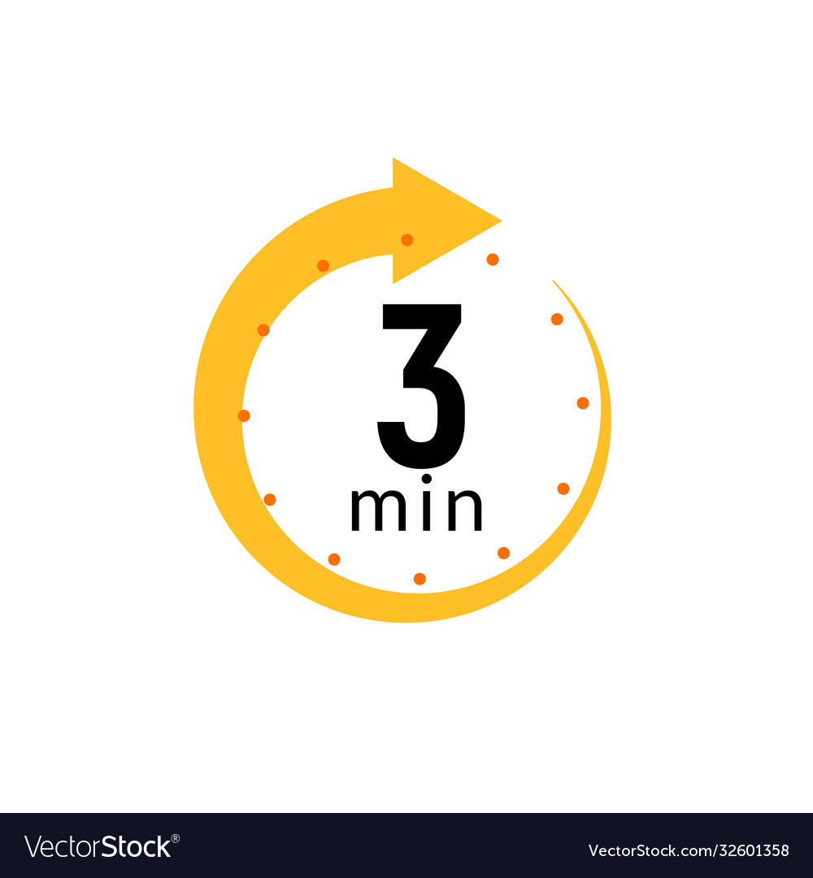
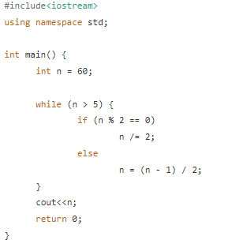
Bonus 3
Guess the output of :
● 1 ● 2
● 3
● 4 ● 0

Slide 48
03
Infinite loops
الطفاية دي

Slide 49
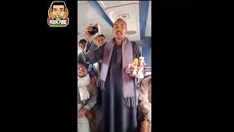
What if the condition is always true?
We get into something that's called an infinite loop, a loop that never stops.

Slide 50
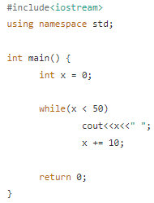
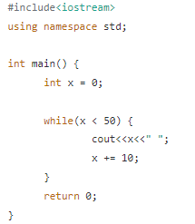
Bonus 1
Guess the output for those two programs :

Slide 51
04
For loops
صباح الفل يعم اشرف معاك احمد حسن من خط حلوان

Slide 52
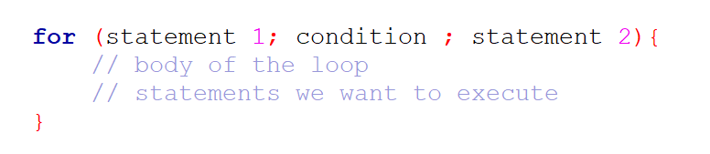
For loop
Statement 1 is executed (one time) before the execution of the code block.
Statement 2 is executed (every time) after the code block has been executed.
A For loop is a repetition control structure that allows us to write a loop that is executed a specific number of times. The loop enables us to perform n number of steps together in one line.
Syntax:

Slide 53
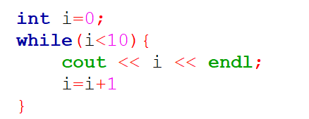
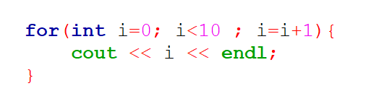
Coding Examples
سكة كدا :When you know exactly how many times you want to loop through a block of code, use the for loop instead of a while loop:

Slide 54

05
Scopes
ال يطلع من داره يتقل مقداره

Slide 55
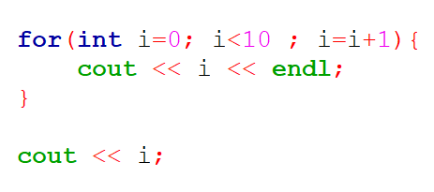
Scopes
In C++, variables are only accessible inside the region they are created. This is called scope.
انت مين

Slide 56
06
Nested loops
لفي بينا يا دنيا

Slide 57
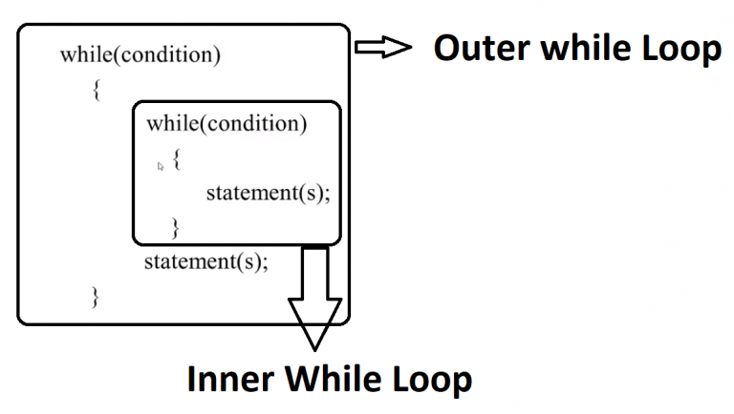
Nested loops
It is also possible to place a loop inside another loop. This is called a nested loop.
The "inner loop" will be executed one time for each iteration of the "outer loop":

Slide 58
“The journey of a thousand miles begins with a single step.”
– Lao Tzu

